Slide 1
Exploring Crowd Consistency in a Mechanical Turk Survey
Peng Sun & Kathryn T. Stolee
{psun2, ktstolee}@ncsu.edu
Computer Science Department
North Carolina State University

Slide 2
Motivation
Crowdsourcing is a common approach for conducting empirical studies in software engineering.
Program synthesis (R. A. Cochran et al. 2015)
Program verification (T. W. Schiller et al. 2012)
Testing (E. Dolstra et al. 2013)

Slide 3
Motivation
Issues:
Distracted.
Random click through.
Unknown.

Slide 4
Motivation
It is important to know how to measure and control response quality.

Slide 5
Research Questions
RQ1: What percentage of MTurk participants have a computer science or IT background?
RQ2: What are the participants’ motivations for using crowdsourcing platform Amazon’s Mechanical Turk?
RQ3: How consistent are the characteristics of samples of participants on MTurk?
RQ4: How consistent are MTurk participants when ask questions about themselves and their experiences?

Slide 6
Research Questions
RQ1: What percentage of MTurk participants have a computer science or IT background?
RQ2: What are the participants’ motivations for using crowdsourcing platform Amazon’s Mechanical Turk?
RQ3: How consistent are the characteristics of samples of participants on MTurk?
RQ4: How consistent are MTurk participants when ask questions about themselves and their experiences?

Slide 7
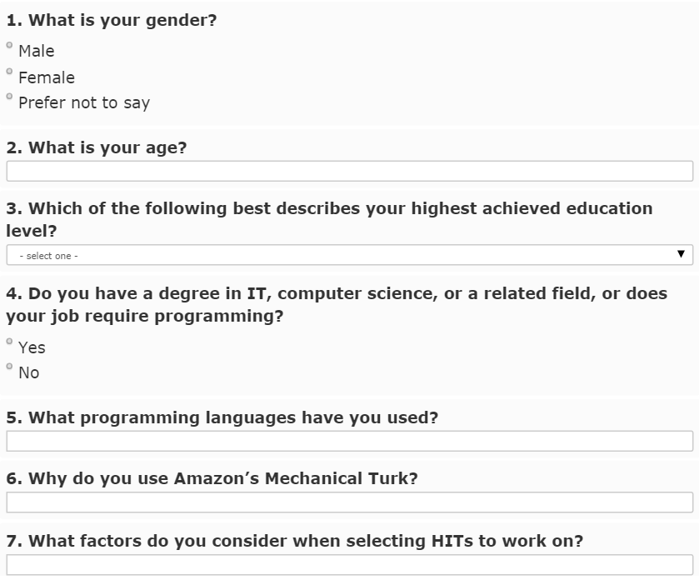

Slide 8
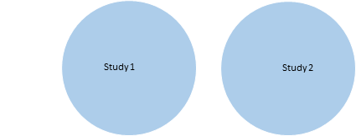
Study Design
n=300
n=300

Slide 9
RQ3: Consistency of sample characteristics
Proportion test of independent sample
from Study 1 and Study 2
Characteristics | Study 1 | Study 2 | p-value
Gender
-Male | 48% | 37% | 0.004934**
-Female | 51% | 63% | 0.004934**
Hold CS Degree
-CS | 36% | 22% | <0.001***
-No-CS | 61% | 77% | <0.001***

Slide 10
RQ3: Consistency of sample characteristics
Multiple study samples provide a more representative sample population.
With large samples of 300 participants, finding significant differences was unexpected.

Slide 11
RQ4: Within-participant consistency
Notes:
Be sure to mention *why* this is consistent.

Slide 12
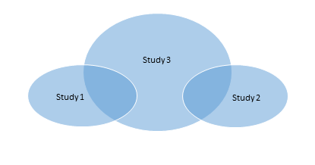
Study Design with Worker Overlap
A
B

Slide 13
Study Design with Worker Overlap
464
214
250
86
50

Slide 14
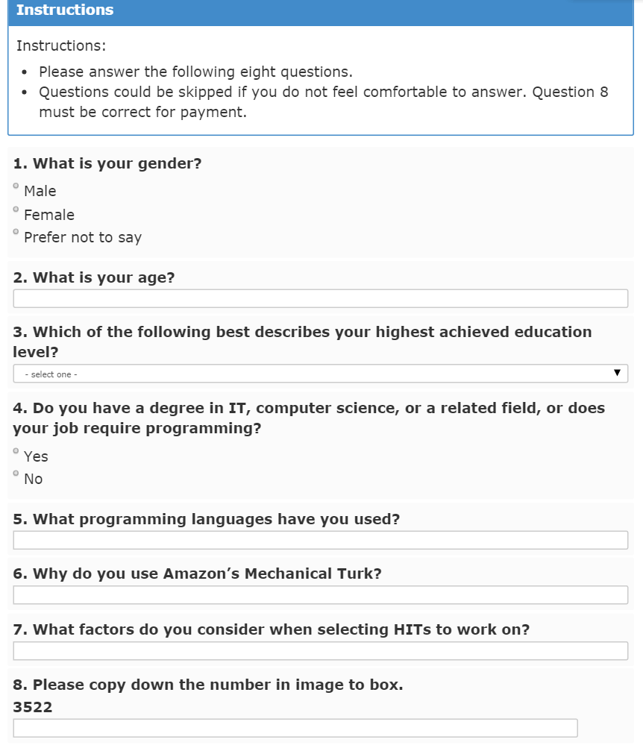
Consistent?
Notes:
As a reminder, show the survey again and identify the questions (visually) used for the consistency analysis

Slide 15
RQ4: Within-participant consistency
Consistency metric - example
Study 1 | Study 3 | Label
Female | Female | consistent

Slide 16
RQ4: Within-participant consistency
Consistency metric - example
Study 1 | Study 3 | Label
Female | Female | consistent
Male |  | consistent
Notes:
Be sure to mention *why* this is consistent.

Slide 17
RQ4: Within-participant consistency
Consistency metric - example
Study 1 | Study 3 | Label
Female | Female | consistent
Male |  | consistent
Male | Female | inconsistent

Slide 18
RQ4: Within-participant consistency
Consistency metric - example
Study 1 | Study 3 | Label
Female | Female | consistent
Male |  | consistent
Male | Female | inconsistent
Male | Prefer not to say | inconsistent

Slide 19
RQ4: Within-participant consistency
Number of questions answered inconsistently
Questions | Participants | Percentage
0 | 95 | 70%
1 | 36 | 26%
2 | 3 | 2%
3 | 2 | 1%

Slide 20
RQ4: Within-participant consistency
Number of questions answered inconsistently
Questions | Participants | Percentage
0 | 95 | 70%
1 | 36 | 26%
2 | 3 | 2%
3 | 2 | 1%

Slide 21
RQ4: Within-participants consistency
Answer Consistency for Repeat Participants
 | Gender (Q1) | Age (Q2) | Edu Level (Q3) | CS Degree (Q4) | Individuals
Consistent | 96% (131) | 91% (124) | 88% (120) | 89% (121) | 70% (95)
Inconsistent | 4% (5) | 9% (12) | 12% (16) | 11% (15) | 30% (41)

Slide 22
RQ4: Within-participants consistency
Answer Consistency for Repeat Participants
 | Gender (Q1) | Age (Q2) | Edu Level (Q3) | CS Degree (Q4) | Individuals
Consistent | 96% (131) | 91% (124) | 88% (120) | 89% (121) | 70% (95)
Inconsistent | 4% (5) | 9% (12) | 12% (16) | 11% (15) | 30% (41)

Slide 23
RQ4: Within-participants consistency
Answer Consistency for Repeat Participants
Of the participants who answered two surveys, 30% answer inconsistently on at least one questions.
 | Gender (Q1) | Age (Q2) | Edu Level (Q3) | CS Degree (Q4) | Individuals
Consistent | 96% (131) | 91% (124) | 88% (120) | 89% (121) | 70% (95)
Inconsistent | 4% (5) | 9% (12) | 12% (16) | 11% (15) | 30% (41)

Slide 24
RQ4: Within-participants consistency
Answer Consistency for Repeat Participants
Of the participants who answered two surveys, 30% answer inconsistently on at least one questions.
This is consistent with prior work that has found 39% of participants do not answer HITs conscientiously (J. S. Downs et al. 2010).
 | Gender (Q1) | Age (Q2) | Edu Level (Q3) | CS Degree (Q4) | Individuals
Consistent | 96% (131) | 91% (124) | 88% (120) | 89% (121) | 70% (95)
Inconsistent | 4% (5) | 9% (12) | 12% (16) | 11% (15) | 30% (41)

Slide 25
RQ4: Within-participant consistency
Consistency of workers with CS/IT background
 | Inconsistent | Percentage
CS | 11/45 | 24%
Non-CS | 9/69 | 13%

Slide 26
RQ4: Within-participant consistency
Consistency of workers with CS/IT background
Participants in the CS group tend to be less consistent than those who do not.
 | Inconsistent | Percentage
CS | 11/45 | 24%
Non-CS | 9/69 | 13%

Slide 27
Were these results a fluke?
Notes:
At this point, you’ve told the audience a lot about how MTurk is bad, from this one experiment.
Now, we’re curious. When we replicate the survey, are there similar types of inconsistencies?

Slide 28
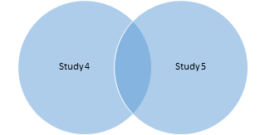
Replication
273
273
Same Survey.
27

Slide 29
Replication
Respondents are more likely to pay effort to answer a survey if they perceive they are valuable for research (J. A. Krosnick et al. 1991).

Slide 30
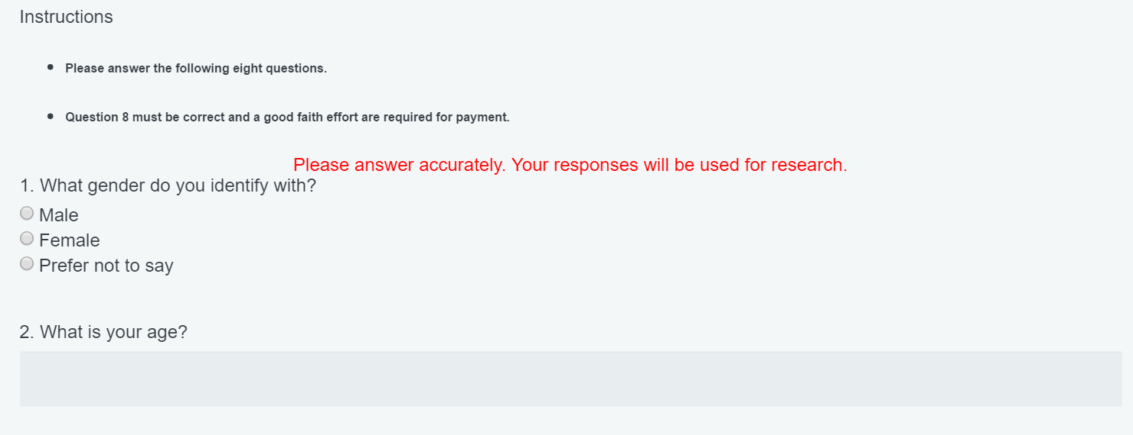


Slide 31
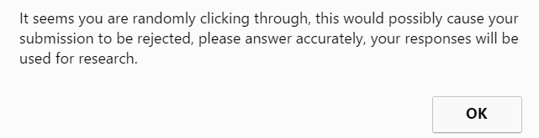
Replication

Slide 32
Comparison
Results in Paper
Replication
30% (41/136) inconsistent.
30% (8/27) inconsistent.

Slide 33
Comparison
Results in Paper
Replication
30% (41/136) inconsistent.
Gender, CS background are significantly different across samples.
30% (8/27) inconsistent.
No significant difference found in characteristics across samples.

Slide 34
Comparison
Results in Paper
Replication
30% (41/136) inconsistent.
Gender, CS background are significantly different across samples.
30% (8/27) inconsistent.
No significant difference found in characteristics across samples.
Students are significantly less likely to be warned.

Slide 35
Implications
The inconsistency rate in the paper is not a fluke.
Needs to use other strategies to ensure workers are mindfully performing tasks.

Slide 36
Improving workers’ conscientious response
Despite prior research, we showed that strategies below did not work well:
Making participants perceive they are valuable for research.
Warning participants when empty answers or spending short time happens.
So….. what can be done?

Slide 37
Next Steps
Try our strategies with larger overlapped samples.
Find other ways to make respondent respond mindfully.
Can money buy consistency?
3. Train underskilled crowd to perform tasks require expertise.
Instructional tutors.
Gold standard.

Slide 38
Exploring Crowd Consistency in a Mechanical Turk Survey
Peng Sun, psun2@ncsu.edu
Katie Stolee, ktstolee@ncsu.edu

Slide 39
RQ1: Percentage of Computer Science experience workforce
Approximately 24% of MTurk worker are potentially qualified.
The most known programming language is Java. Metrics: bag of words.
The pool of participants is also particularly well educated with 70% having a college degree.

Slide 40
RQ2: Workers’ Motivation
Most participants (86%) use MTurk for payment.
Metrics:
keywords: “money”, “cash”, “income”, “pay”, “part time”, “payment”, and “earn” from bag of words analysis for Question 6.

Slide 41
Threats to Validity
Internal validity:
Samples are biased toward people who want money, impacting the results of motivations.

Slide 42
Threats to Validity
External validity:
Larger sample.
Other crowdsourcing platforms.

